Slide 1
Material Optimization and Vibrational Analysis of Tie Rod
Project Group Number:16
Project Member1: Pauskar Sunil Umesh Roll No.: MBC-45
Project Member 2: More Vikas Harishchandra Roll No.: MBC-23
Project Member 3: Pise Chaitali Kushaba Roll No.: MBC-02
Project Member 4: Ssonawane Adeeth Ankushrao Roll No.: MBD-34
Project Guide: Prof.Y.S. Khairnar

Slide 2
Problem Statement
For competitive racing wagon i.e. go kart we need to improve efficiency of vehicle with optimum weight. By studying on steering system we found that we can reduce weight of kart also can improve efficiency.

Slide 3

Problems Faced:-
Weight Reduction
Failure of component
Torque requirement

Slide 4
Objectives of Project
Study of various parameter resulting in Tie Rod
Theoretical analysis of component
To enhance knowledge related to CAD and CAE Software
To do experimentation and acquire knowledge related to FFT Analyzer setup
Weight reduction in the component
To improve safety for personnel

Slide 5
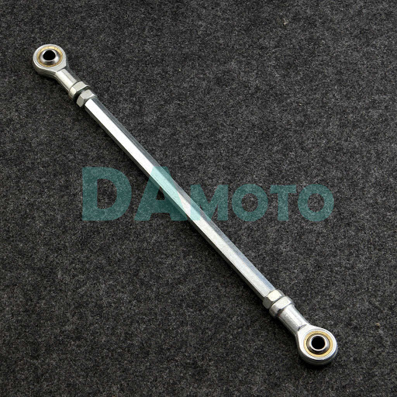
Introduction
Part of steering mechanism (Slender structural)
Capable of carrying Compressive Loads only.

Slide 6
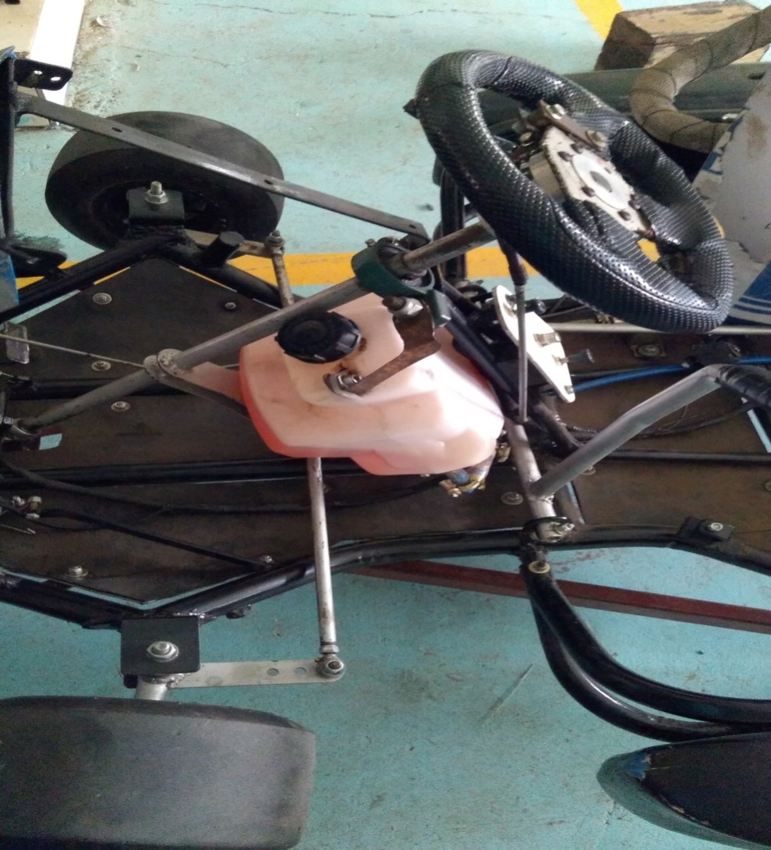
Steering System of Go-kart
Requirements:-
Simple, lightweight and easily operated steering system.
100% Ackerman steering.
The need of directional stability of our vehicle
To provide directional control of the vehicle with minimum input.

Slide 7
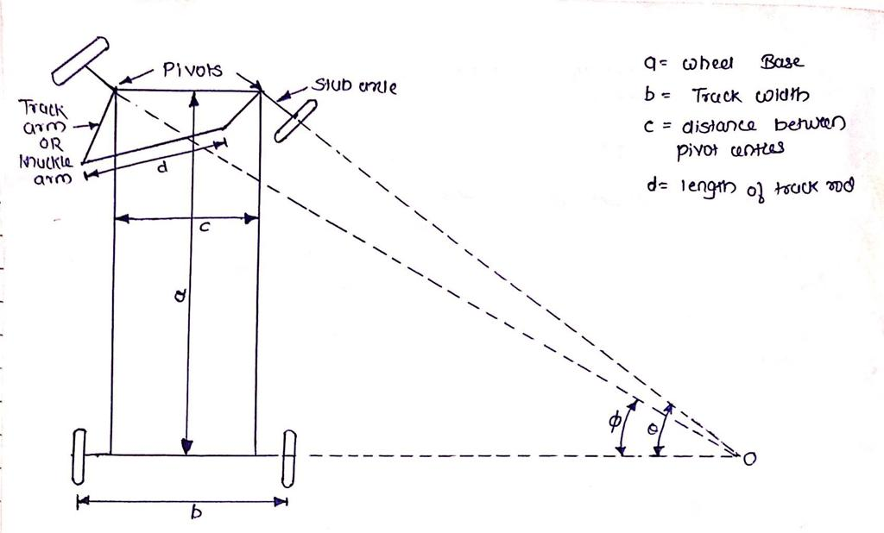
Improvement needed in Steering system
Weight Reduction
Life of system
Improve Vibration Capacity
Part Selected:-
Tie Rod (Both Sided)

Slide 8
Methodology
Selection of component
Collecting information
Theoretical calculation
Manufacturing and Machining
Analysis of part
To make Cad part
Documentation work
Experiment on FFT Analyzer
Result and Conclusion

Slide 9
Old Tie Rod
Material – Mild steel
Specification
Parameter | Units | Values
Young's Modulus | (GPa) | 210
Yield Strength | (MPa) | 172-250
Tensile strength | (MPa) | 400
Poisson's Ratio |  | 0.3
Melting Point | (Deg) | 1538
Density | (g/cm*3) | 7.85
Tie rod Parameter | Dimension
Length | 250 mm
Diameter | 12 mm
Length | 30 mm

Slide 10
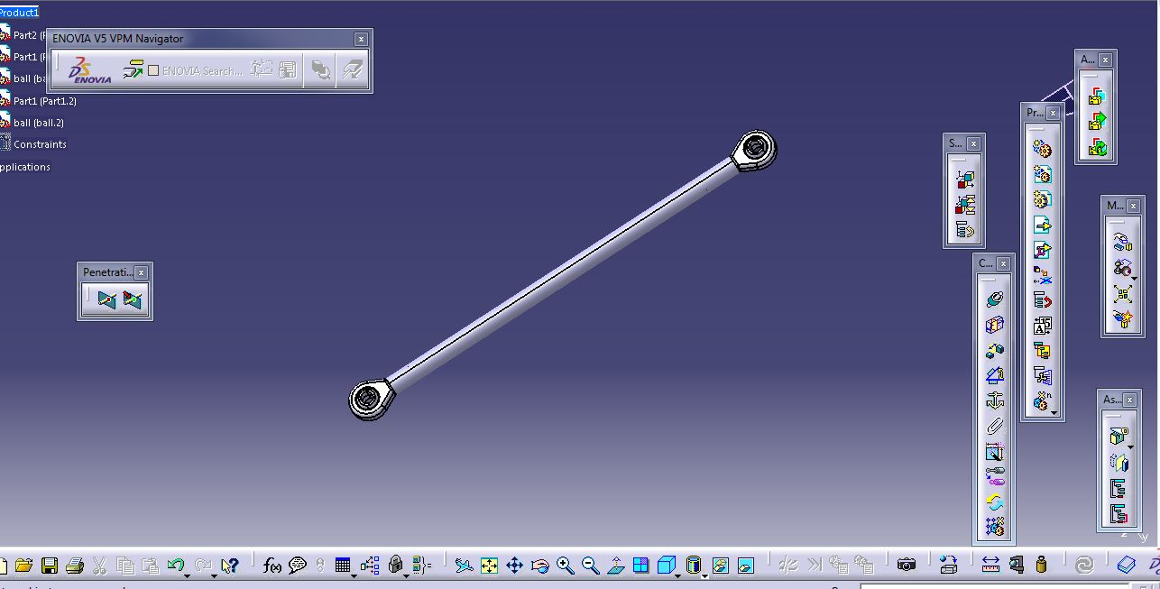
Cad part of Tie rod

Slide 11
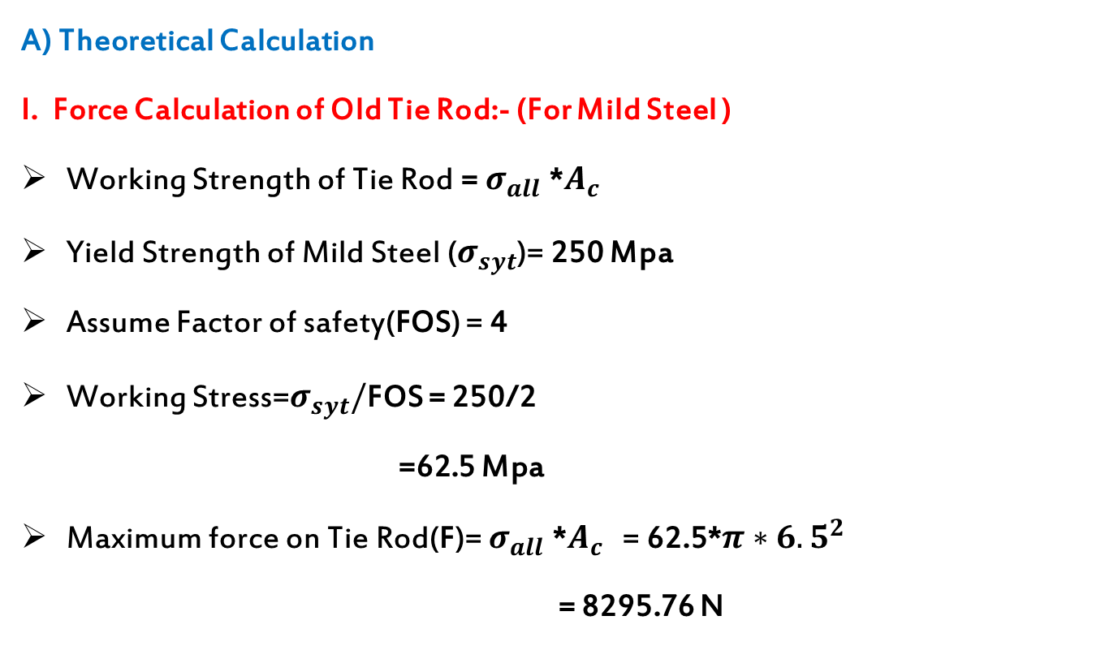
Calculation
A) Theoretical Calculation
I. Force Calculation of Old Tie Rod:- (For Mild Steel )
Working Strength of Tie Rod = $σ_{all}$ *$A_{c}$
Yield Strength of Mild Steel ($σ_{syt}$)= 250 Mpa
Assume Factor of safety(FOS) = 4
Working Stress=$σ_{syt}/$FOS = 250/2
=62.5 Mpa
Maximum force on Tie Rod(F)=$σ_{all}$ *$A_{c}$ = 62.5*$π{∗6.5}^{2}$
= 8295.76 N

Slide 12
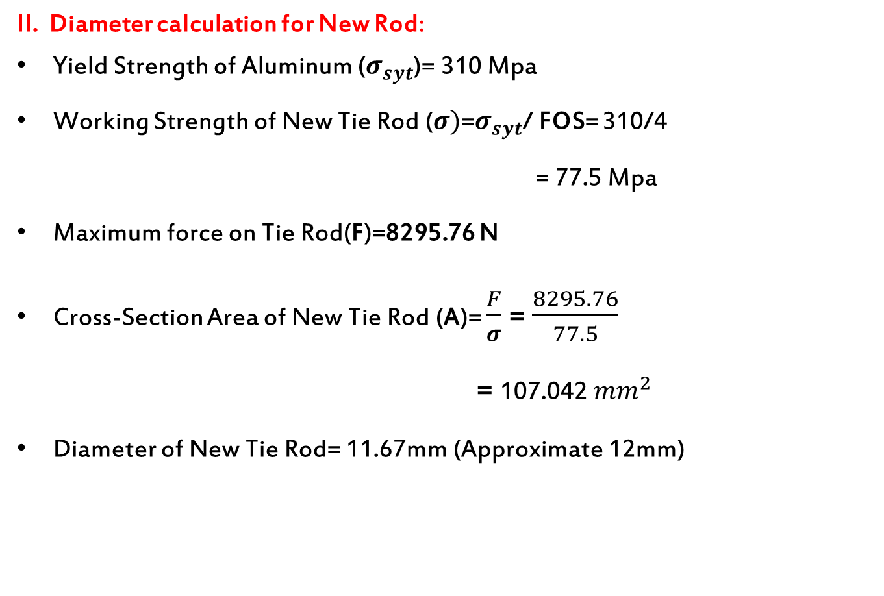
II. Diameter calculation for New Rod:
Yield Strength of Aluminum ($σ_{syt}$)= 310 Mpa
Working Strength of New Tie Rod ($σ)$=$σ_{syt}$/FOS= 310/4
= 77.5 Mpa
Maximum force on Tie Rod(F)=8295.76 N
Cross-Section Area of New Tie Rod (A)= $\frac{F}{σ}$ = $\frac{8295.76}{77.5}$
= 107.042 ${mm}^{2}$
Diameter of New Tie Rod= 11.67mm (Approximate 12mm)

Slide 13
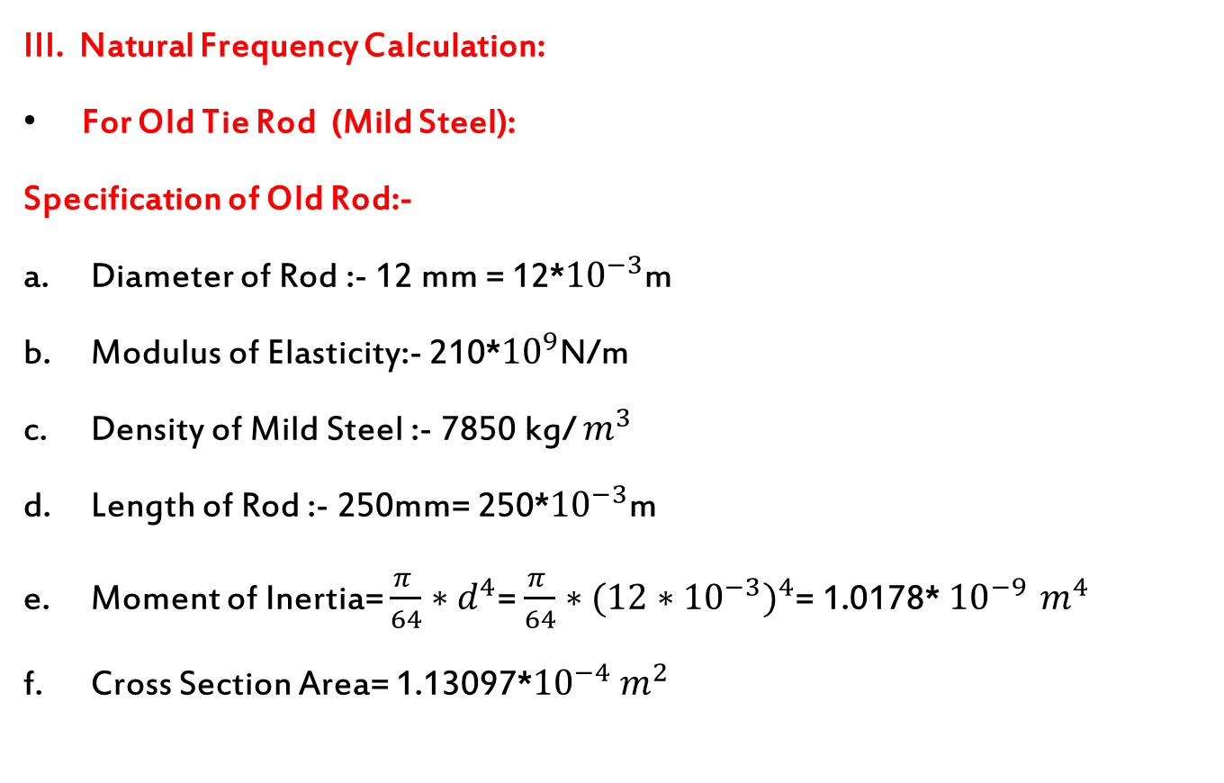
III. Natural Frequency Calculation:
For Old Tie Rod (Mild Steel):
Specification of Old Rod:-
Diameter of Rod :- 12 mm = 12*${10}^{−3}$m
Modulus of Elasticity:- 210*${10}^{9}$N/m
Density of Mild Steel :- 7850 kg/ $m^{3}$
Length of Rod :- 250mm= 250*${10}^{−3}$m
Moment of Inertia= $\frac{π }{64}∗d^{4}$=$\frac{π }{64}∗({12∗{10}^{−3})}^{4}$= 1.0178* ${10}^{−9 }$$m^{4}$
Cross Section Area= 1.13097*${10}^{−4}$$m^{2}$

Slide 14
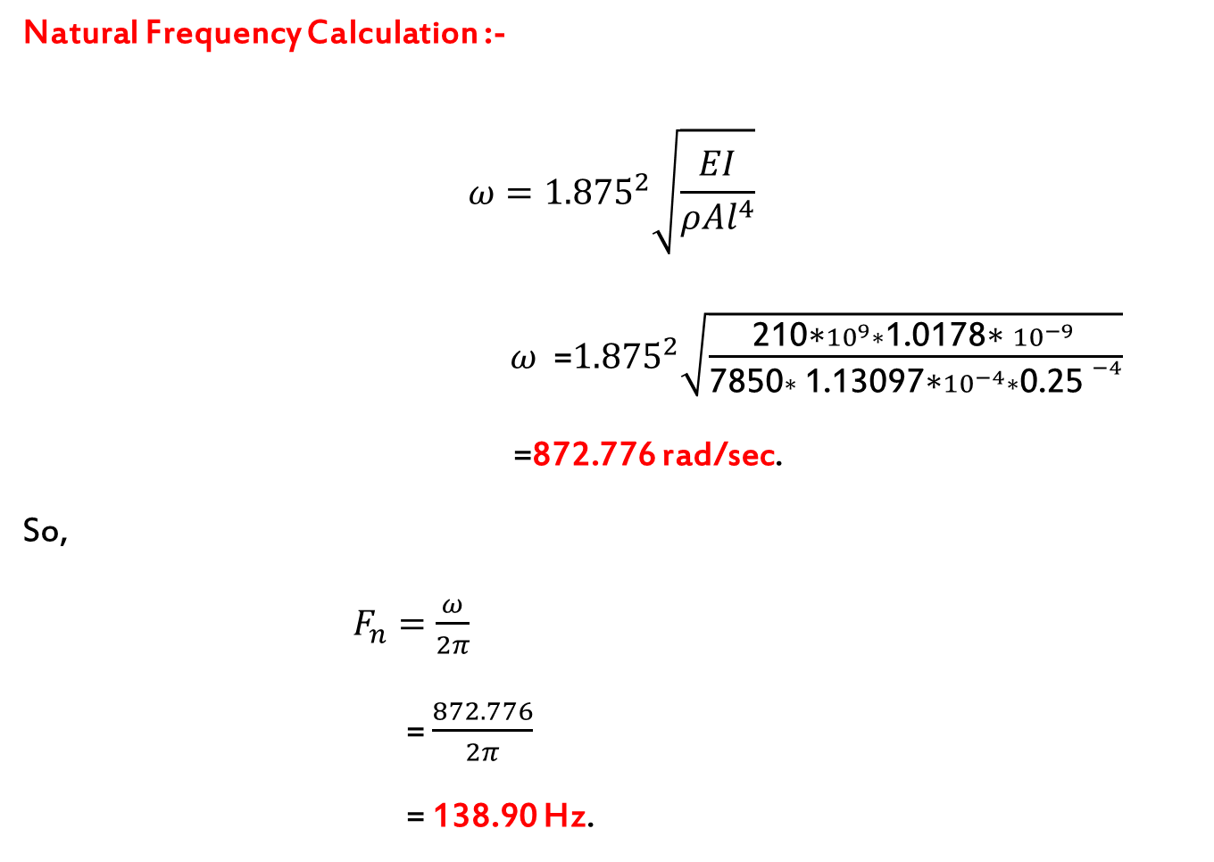
Natural Frequency Calculation :-
$$ω={1.875}^{2}\sqrt{\frac{EI}{ρAl^{4}}}$$
$ω$ =${1.875}^{2}\sqrt{\frac{\text{210∗}{10}^{9}∗\text{1.0178∗ }{10}^{−9 }}{\text{7850}∗\text{ 1.13097∗}{10}^{−4}∗{\text{0.25 }}^{−4}}}$
=872.776 rad/sec.
So,
$F_{n}=\frac{ω}{2π}$
= $\frac{872.776}{2π}$
= 138.90 Hz.

Slide 15
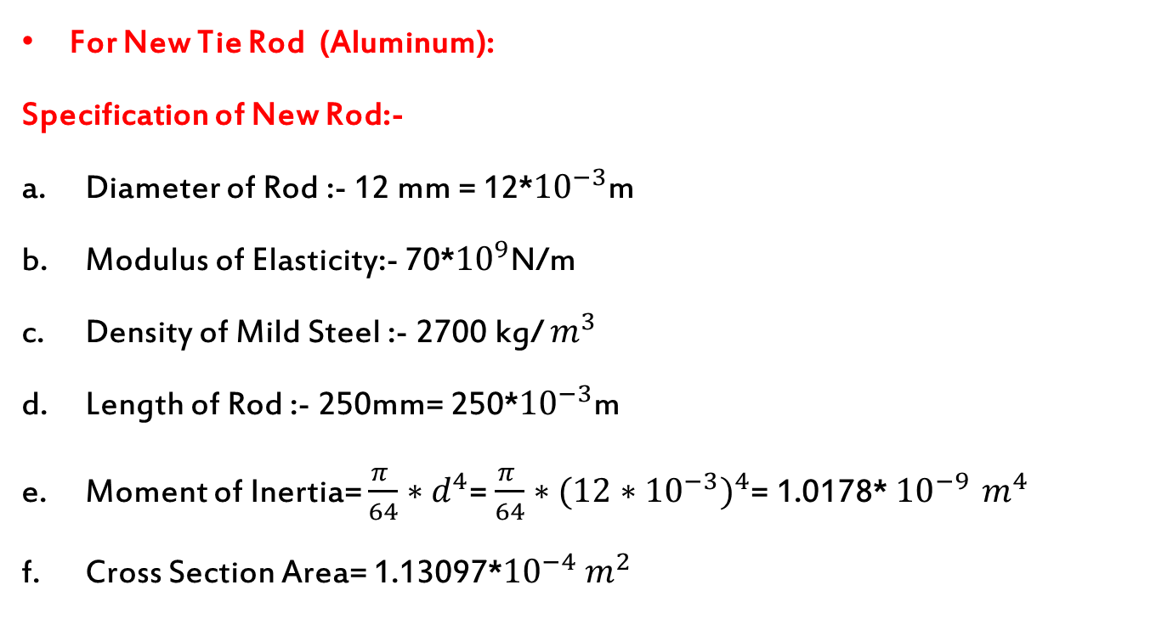
For New Tie Rod (Aluminum):
Specification of New Rod:-
Diameter of Rod :- 12 mm = 12*${10}^{−3}$m
Modulus of Elasticity:- 70*${10}^{9}$N/m
Density of Mild Steel :- 2700 kg/ $m^{3}$
Length of Rod :- 250mm= 250*${10}^{−3}$m
Moment of Inertia= $\frac{π }{64}∗d^{4}$= $\frac{π }{64}∗({12∗{10}^{−3})}^{4}$= 1.0178* ${10}^{−9 }$$m^{4}$
Cross Section Area= 1.13097*${10}^{−4}$$m^{2}$

Slide 16

Natural Frequency Calculation :-
$$ω={1.875}^{2}\sqrt{\frac{EI}{ρAl^{4}}}$$
$ω$ =${1.875}^{2}\sqrt{\frac{\text{70∗}{10}^{9}∗\text{1.0178∗ }{10}^{−9 }}{\text{270}\text{0}∗\text{ 1.13097∗}{10}^{−4}∗{\text{0.25 }}^{−4}}}$
=859.23 rad/sec.
So,
$F_{n}=\frac{ω}{2π}$
= $\frac{859.23}{2π}$
= 136.75 Hz.

Slide 17
New Tie Rod
Material - Aluminum
Specification
Parameter | Units | Values
Young's Modulus | (GPA) | 69
Yield Strength | (MPA) | 275
Tensile strength | (MPA) | 125
Poisson's Ratio |  | 0.3
Melting Point | (deg) | 660.3
Density | (g/cm*3) | 2.7
Tie rod | Dimension
Length | 250 mm
Diameter | 12 mm
Tie End
Length | 30 mm

Slide 18
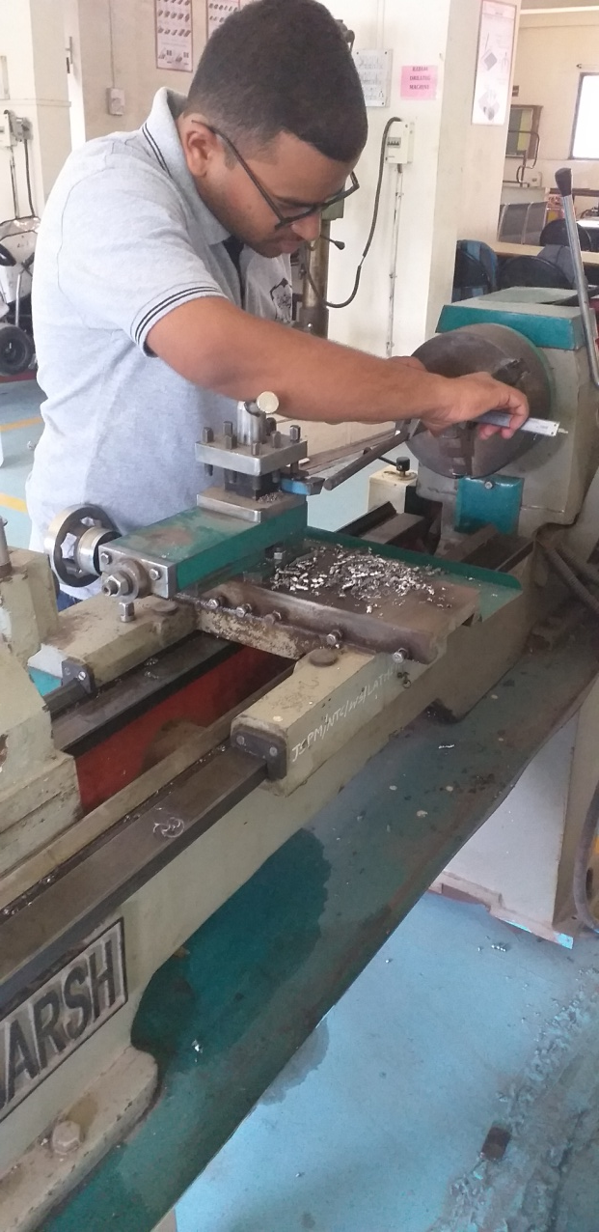
Manufacturing

Slide 19
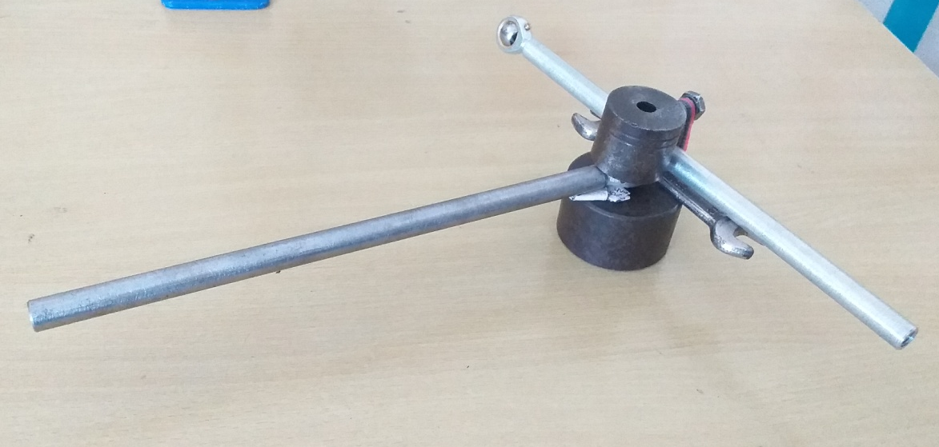
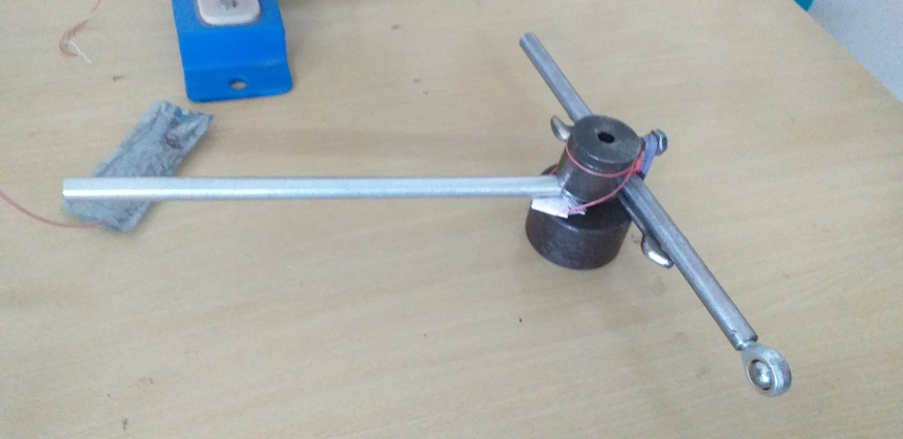
Fixture for experimental setup
: Fixture for MS tie rod
Fixture for Aluminium tie rod :

Slide 20
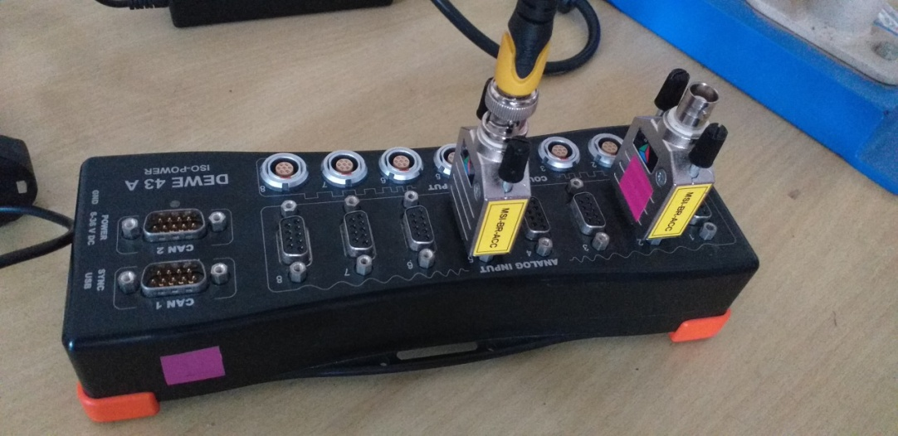
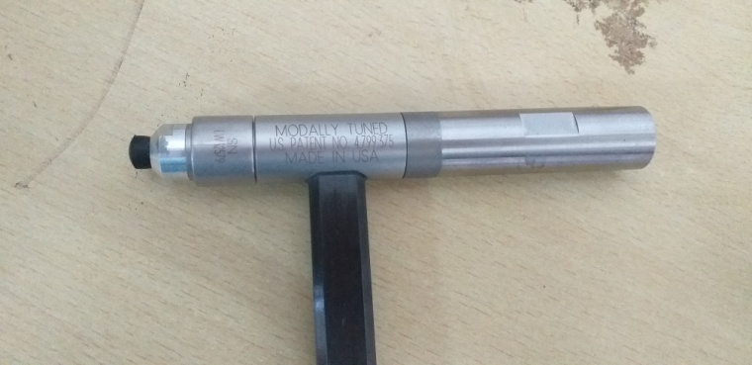
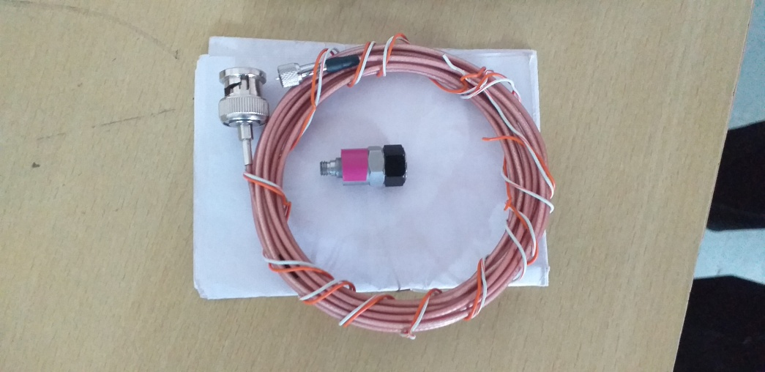
Apparatus
Impact Hammer With Load Sensor
Data acquisition system with amplifiers
Accelerometer

Slide 21
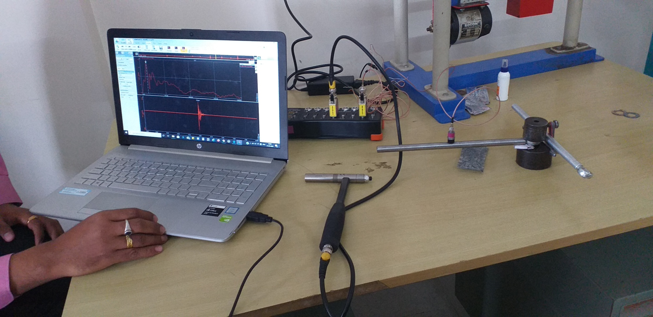
Experimental setup

Slide 22
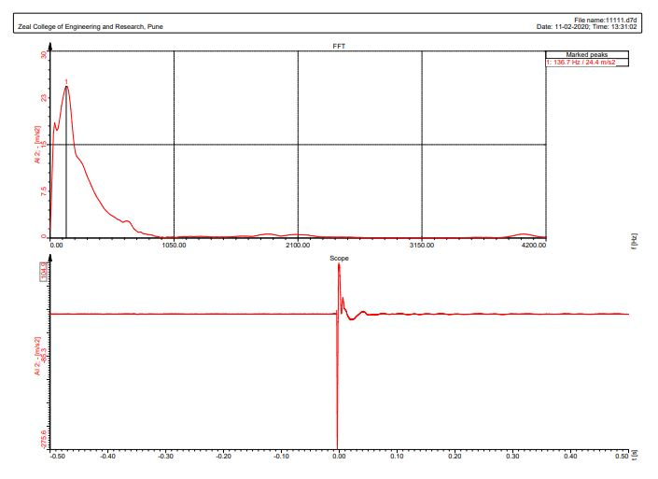
Experimental analysis
Mild Steel

Slide 23
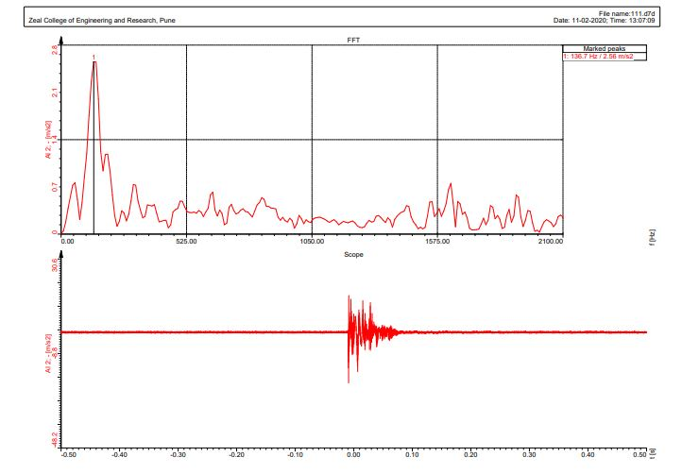
Aluminum

Slide 24
Static Analysis of Cad parts
Mild steel
Aluminum

Slide 25
Modal Analysis
A modal analysis is a technique used to determine the vibration characteristics of structures:
• natural frequencies
• mode shapes
Benefits of modal analysis:
Allow to design to resonant vibrations
Idea of design respond to different dynamic loads
Helps in calculating solution control

Slide 26
Modal Analysis of CAD Parts
Mild steel
Aluminum

Slide 27

Results
I. Weight Reduction
Sr. No. | Material | Weight (kg)
1 | Mild Steel | 0.2055
2 | Aluminum | 0.0705
Weight Reduction in %
% of Weight Reduction=$\frac{Weight of Mild Steel−Weight of Aluminum}{Weight of Mild Steel}∗100$
=$\frac{0.2055−0.0705}{0.2055}∗$100
= 65.69

Slide 28
II. Natural Frequency
Sr no. | Material | Mode | Theoretical (Hz) | Experimental (Hz) | % of Error
1 | Mild Steel | 1 | 138.90 | 136.7 | 1.5
2 | Aluminum | 1 | 136.75 | 136.72 | 0.02
III. Cost of Material
Sr.No. | Material | Cost per Kg
1 | Mild Steel | Rs. 130
2 | Aluminum | Rs. 220

Slide 29
Advantages and limitation of Project
Advantages:-
Limitation
Weight Reduction up to 66%
Increase the efficiency and torque requirement
Cost is little bit more

Slide 30

Thank you

